Slide 1
Partial Page Update
November 21, 2014
Notes:
Guidewire training materials contain Guidewire proprietary information that is subject to confidentiality and non-disclosure agreements. You agree to use the information in this manual solely for the purpose of training to implement Guidewire software solutions. You also agree not to disclose the information in this manual to third parties or copy this manual without prior written consent from Guidewire. Guidewire training may be given only by Guidewire employees or certified Guidewire partners under the appropriate agreement with Guidewire.
<number>

Slide 2
Identify properties associated with dynamic widget behaviors
Describe common ways to configure a partial page update
Enable and configure targeted Post On Change for a widget
Notes:
<number>

Slide 3
Review of dynamic widget properties
Dynamic widget behavior and partial page update
Configuring targeted partial page update with PostOnChange
Notes:
<number>

Slide 4
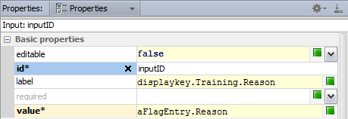
Two kinds of widget properties
Static Property
Evaluates a static value that is immutable, never changes
id requires a static value
Dynamic Property
After a user navigates to a page or clicks update, evaluates an expression and returns an value
editable requires boolean expression
label returns a string expression
value returns an object expression
Notes:
In the slide example, the id property of a widget is a static property. The widget always has the same ID, regardless of the state of the application or the values of any business data. The property does not evaluate an expression, just the value of a type, such as a String or Integer value.
The editable property evaluates a boolean expression and the expression can be a dynamic value, in this case, one that returns true or false. The label property evaluates a string expression. This lesson discusses display keys later on. Display keys are a type of string expression in Guidewire applications for localizing text. The value property is also a dynamic property. The value property evaluates an object expression that binds the object property to it.
Both types of widget properties can be required properties for a specifc type of widget.
<number>

Slide 5
Dynamic properties evaluate expressions
Available
Boolean expression which, if false, grays out the widget and its children
Editable
Boolean expression which, if false, makes the widget and its children read-only
Required
Boolean expression which, if true, then a value must be filled out by the user
Visible
Boolean expression which, if false, completely hides the widget and its children
Notes:
Not all widgets have all properties. Refer to the PCF Format Reference for more examples. Recall that the PCF Format Reference defines the properties for every widget, including the type of value the property takes. Note that the PCF Format Reference refers to widget properties as "attributes".
To open the PCF Format Reference, open <ApplicationRootDirectory>\modules\pcf.htm file in your web browser.
You can also consider the value property of a widget to be a dynamic property because it evaluates an object expression.
Visible is typically not set to false. It is either set to true or it is set to an expression that renders the widget visible or not visible. The default value for the visible property is true.
<number>

Slide 6
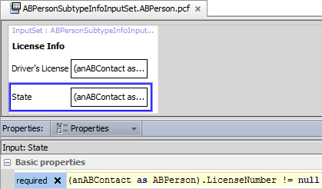

Example: required
When the boolean expression evaluates to true, the field is required
Required is true when there is value for the LicenseNumber
Notes:
<number>

Slide 7
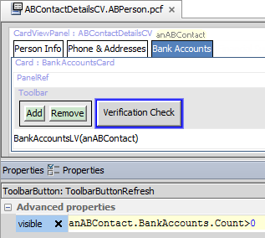
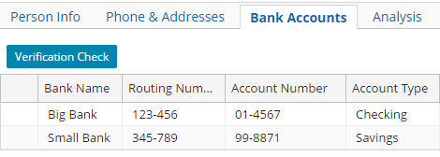
Example: visible
When the boolean expression evaluates to true, the button is visible
Visible only when there one or more bank accoutnts
Notes:
<number>

Slide 8
Review of dynamic widget properties
Dynamic widget behavior and partial page update
Configuring targeted partial page update with PostOnChange
Notes:
<number>

Slide 9
Dynamic property and dynamic behavior
Dynamic Property
Dynamic Behavior
After a user navigates to a page or clicks Update, the widget property expression is evaluated
Reflects committed data
While a user changes business data, the widget property expression evaluated
Reflect uncommitted changes to data!
Applicable to the dynamic properties of a widget
Partial page update configuration required!
Notes:
Dynamic widget behavior does not require that the user commit the data (the user clicks the Update button) or navigate to the page.
Partial page update configuration enables dynamic widget behavior so that a user navigating does not need to navigate to a page or commit data changes to see a change to the screen. Partial page updates includes updates to data and/or updates to the screen.
<number>

Slide 10
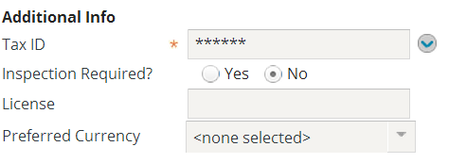
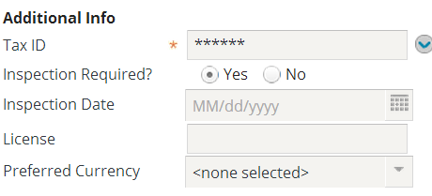
Dynamic widget behavior for layout
Responds to a user changing business data while it happens and changes the layout of widgets on the screen
Example:
While a user changes the Inspection Required? field to Yes, Inspection Date becomes visible
Notes:
Server-Side Widget Behavior - <number>
In the slide example, the Company Info card has both an Inspection Required? field and Inspection Date field. However, the Inspection Date field is visible only if the Inspection Required? field is set to Yes.
The InspectionRequired widget displays a Yes or No radial buttons. A selected Yes radial button equates to true and a selected No radial button equates to false. A null value is represented as neither radial button selected.
Dynamic widget behavior differs from a property that evaluates an expression in that the user changes the business data while editing it and that change affects the behavior of the widget. In the previous examples, the changes are present only after the data has been committed.

Slide 11
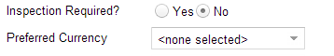

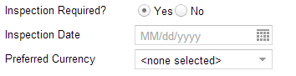
Partial page update: Layout re-render
Layout re-rendered for the page
No data committed
Applies to following dynamic widget properties
Visibility
Editability
Availability
Required
Value Changed
Layout re-rendered
Notes:
There are two general and non-exclusive categories for a partial page update: layout re-render and DATA_ONLY.
In the layout re-render example above, whenever the value of the InspectionRequired field is changed, all user editable data is sent from the client to the application server via AJAX. No data is committed. The server processes the request and returns the user editable data to the client in JSON format. The client renders a partial page update that shows an Inspection Date calendar input.
<number>

Slide 12
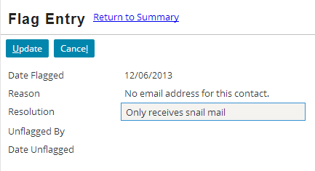
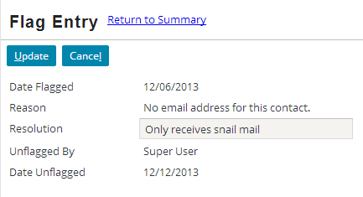
Dynamic widget behavior for data
Responds to a user changing business data while it happens
Not after the user navigates to the page
Not after the user commits or tries to commit the data
Example:
While a user changes the Resolution field, the values for the user and date fields (read-only in UI)
Notes:
Server-Side Widget Behavior - <number>
In the slide example, the widget configuration enables dynamic widget behavior for the Resolution TextAreaInput widget. When a user changes the value of the Resolution field, the client web browser makes an AJAX HTTP request to the Guidewire application. The Guidewire application processes the request and returns instructions to the client web browser. In this case, the instructions tell the client web browser via JSON and JavaScript to re-render only the newly supplied data for the Unflagged By and Date Unflagged fields.

Slide 13


Partial page update: DATA_ONLY
Data is updated for the page
No data committed
Applies to only one dynamic widget property:
Value
Value Changed
Data updated
Notes:
There are two general and non-exclusive categories for a partial page update: DATA_ONLY and a layout re-render.
In the DATA_ONLY example, whenever the value of the Resolution field is changed, all user editable data is sent from the client to the application server via AJAX. No data is committed. The server processes the request and returns the user editable data to the client in JSON format. The client renders a partial page update that shows new data for the Unflagged By and Date Unflagged fields.
DATA_ONLY applies to the value property of a widget. Examples include refreshing an input group and refreshing a set of fields on a cell change in a list view.
<number>

Slide 14
Review of dynamic widget properties
Dynamic widget behavior and partial page update
Configuring targeted partial page update with PostOnChange
Notes:
<number>

Slide 15
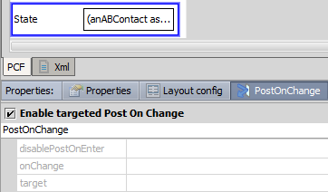
Partial page update is PostOnChange
Dynamic widget behavior for data and layout changes require partial page update configuration
Configurable widgets
Cell
Input
InputGroup
See pcf.xsd for schema support
PostOnChange tab property
Mark the Enable targeted Post On Change checkbox
Three (3) configurable properties
disablePostOnEnter, onChange, target
Notes:
In order to improve data entry efficiency and reduce page refresh, you can configure input widgets and cell widgets to dynamically react to user input using targeted Post On Change. With targeted Post On Change enabled, it is possible to updated field values on the page and/or re-render the entire layout or a partial page layout.
Post On Change is a Boolean tab property in Guidewire Studio and allows you to define three additional properties: disablePostOnEnter, onChange, and target.
<number>

Slide 16
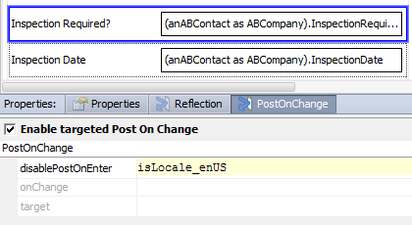
Property: disableOnEnter
Default is false
If evaluated to true, not triggered when page is rendered
Example:
If the locale is en_US, then behavior disabled
Value Changed
Notes:
In certain cases, you may want to toggle (disable or enable) targeted Post On Change behavior for a specific widget.
In the layout example above, targeted Post On Change is enabled for the InspectionRequired input widget. However, the disablePostOnEnter property is set to the isLocale_enUS variable. A variable evaluation of true disables the targeted Post On Change behavior for the InspectionRequired widget. When the disablePostOnEnter property is true, the InspectionRequired widget will not announce a change in its value; data will not make a round-trip between client and the application server; the page will not be re-rendered; and unless the InspectionRequired field is already true for the given ABContact, the InspectionDate widget will not be visible.
<number>

Slide 17
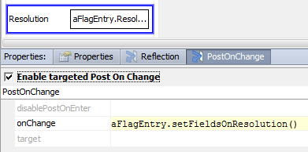
Property: onChange (1)
Defines the Gosu expression to invoke
Applicable when user changes the editable value of a widget
Causes immediate post back to server
High cost to server-side processing in PCF configuration, especially if complex
Upgrade support for onChange widget property
Notes:
In the slide example, the Gosu expression defined for the onChange property invokes the setFieldsOnResolution() function. The function is defined in the entity enhancement, FlagEntryEnhancement.gsx.
16 /* This function is called when a FlagEntry's resolution field 17 is set. This function sets the UnflagDate and UnflagUser
18 fields. This serves the role of a "FlagEntry Pre-Update"
19 rule set.
20 */
21 function setFieldsOnResolution() : void {
22 this.UnflagDate = gw.api.util.DateUtil.currentDate()
23 this.UnflagUser = User.util.getCurrentUser()
24 } // end of function
<number>

Slide 18
Property: onChange (2)
onChange is a widget property that executes code whenever widget's value changes
Triggers changes to other widgets prior to the value being saved
<PostOnChange/> must be present for onChange to trigger
Notes:
In order to improve data entry efficiency and reduce page refresh, you can configure input widgets and cell widgets to dynamically react to user input using targeted Post On Change. With targeted Post On Change enabled, it is possible to updated field values on the page and/or re-render the entire layout or a partial page layout.
Post On Change is a Boolean tab property in Guidewire Studio and allows you to define three additional properties: disablePostOnEnter, onChange, and target. The PostOnChange property tab contains the Enable targeted Post On Change checkbox. When checked, the three additional properties are editable.
In the slide example, whenever the value of the Resolution field changes and the user makes some other widget active, the setFieldsOnResolution function executes. If the code executed by onChange modifies any field values, these modifications are done to the run-time objects only. In other words, the new values will be displayed in the user interface, but the values are not yet committed to the database. In fact, the changed values will never be committed unless something else explicitly commits the data (such as being in Edit mode and then clicking the Update button).
<number>

Slide 19
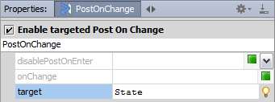

Property: target — widget ID
Target widget re-rendered
Refreshes all user-editable page data
Example:
DriversLicense widget specifies State as target
Partial page update causes re-render for target widget
State widget’s required property enabled
Input: DriversLicense
Validation enabled with layout re-render
Notes:
The target property defines the scope and behavior of a page update. Triggering refreshes all user-editable data, but only the target widget is re-rendered with a new layout. The following widget types are supported targets:
• inline input widget (individual input)
• inline input set
• inline input panel (DV panel or LV panel)
• included panel (Panel ref)
• exposed panel or input set
• label widget
In the slide example, targeted Post On Change is enabled for the DriversLicense input widget. The target is the State widget. When a user edits the Driver’s License field, the change is announced to the State field. Only the layout of the State field is updated, causing the validation expression to equal to true as it is dependent on the existence of a value in the Driver’s License field. All other user-editable data is also refreshed.
<number>

Slide 20
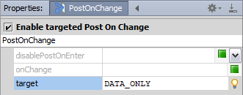
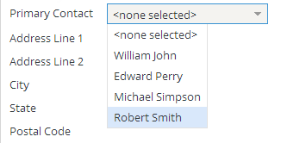
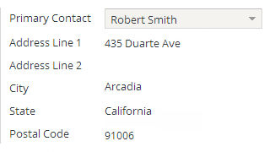
Property: target — DATA_ONLY
RangeInput: PrimaryContact
Refreshes all user-editable page data
Input data
ListViewPanel row data
NO layout updates
Best performing
Notes:
The target property defines the scope and behavior of a page update. When DATA_ONLY is specified, only the user-editable page data is refreshed. There are no layout updates.
In the slide example, targeted Post On Change is enabled for the PrimaryContact RangeInput widget. The target is DATA_ONLY. When a user edits the Primary Contact field, the change causes all user-editable data to be refreshed. The result is that the data is refreshed for Address Line 1, Address Line 2, City, State, and Postal Code fields. With the DATA_ONLY target value, no layout updates are made.
<number>

Slide 21
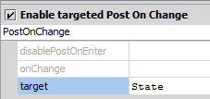
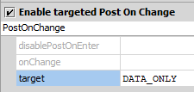
Review of target property
Layout re-render
Data update
Widget ID
Target area re-rendered
All editable data refreshed
DATA_ONLY
No layout re-render
All editable data refreshed
Best performing
Notes:
When specified as a widget, the target area can be a specific widget or a grouping of widgets. For example, if the Widget ID corresponds to an Input Set, then the widgets in the input set are re-rendered.
There is an additional layout re-render configuration for backwards compatibility: no value. The no value configuration consists of enabling targeted post on change alone with no property configurations. The backwards compatibility configuration has no property values specified and causes the re-rendering of the entire page and refreshes all user-editable data. There is a high performance cost for implementing targeted Post On Change without specifying a target and any other properties.
<number>

Slide 22
Identify properties associated with dynamic widget behaviors
Describe common ways to configure a partial page update
Enable and configure targeted Post On Change for a widget
Notes:
<number>

Slide 23
Describe two properties that evaluate expressions.
How is a partial page update implemented?
What are the three properties that you can configure for a widget with targeted Post On Change enabled?
What are two configurations for the target property? Which is the best performing? Why?
How can you refresh the layout of several related widgets by enabling targeted Post On Change on one trigger widget?
Notes:
Answers
1) Possible answers include:
Required -- Expression defined in required property
Visible -- Expression defined in visible property
2) A partial page update is implemented by configuring dynamic widget behavior by enabling targeted post on change. Often the dynamic widget behavior configuration also includes configuring an expression for a widget property. 3) disableOnEnter, onChange, and target.
4) DATA_ONLY or a specific id? DATA_ONLY refreshes only the user-editable data and is often the best performing.
5) If there are several widgets that for which you need to refresh the layout or update the data, consider wrapping the related widgets into an Input Set widget.
<number>

Slide 24
Notes:
<number>

